Slide 1



AI & LLM with
2024 Summer Workshop
Dr. Timothy D.
Bowman "Dr. B"
Timothy D Bowman, PhD (Tim or Dr B) he/him/his
Associate Professor, The iSchool
tbowman@dom.edu
Phone: (708) 524-6653
Office Room: Crown 324,
7900 Division Street,
River Forest, IL 60305

Slide 2
Workshop Info:
Place: The workshop will take place on campus in Lewis 002. This is one of the computer classrooms in the Tech Center.
Time and dates: Monday, August 12 to Friday, August 16 from 9 am to 4 pm. Let me know if you can’t be there for the entire workshop.
Lunch: Lunch will be provided on campus each day of the workshop.
Payment: Students who complete the entire workshop and participate in presenting their group project at the fall URSCI Mini-Expo (Sept. 5, 5-7pm in Parmer Hall) will be eligible for a financial aid payment of $1000.
To receive this payment, you must also have filed a FAFSA with DU and not exceed your cost of attendance. If you will exceed your cost of attendance, you may still participate in the workshop, but we cannot award the payment. If you have any questions, please reach out to finaid@dom.edu.

Slide 3




Who is Dr. B?
Chicago, Dec 2023
Dr. Timothy D Bowman is from Bedford, IN, USA.
I study altmetrics / social media / AI / LLMs
I was an IT professional for over 15 years.
I am 51 years old and I am a Gemini.
I have a wife Sarah, 2 cats Bunsen and Beaker, and our sweet dog Denali.
I have no children.
I am a self-proclaimed geek and I used to be a skate punk/punk.
Sarah and I have lived in Canada (Montreal) and in Finland (Turku), though I still can only speak English fluently.
I have visited 44 of the 50 United States.
Sarah and I have visited 20 out of 195 countries (we haven't been to Africa, Antarctica, or Australia, or South America yet)
I have been in academia as a faculty member for 9 years
I earned my undergraduate BS degree in Psychology (NeuroPsychology) from Indiana State University.
I earned my Master's Degree in Information Science and a Ph.D. in Information Science from Indiana University Bloomington
My hobbies include woodworking, 3D printing, DIY'ing, and contemplating
I am also an avid audiobook listener
Tim
Sarah
Beaker
Bunsen
Denali

Slide 4
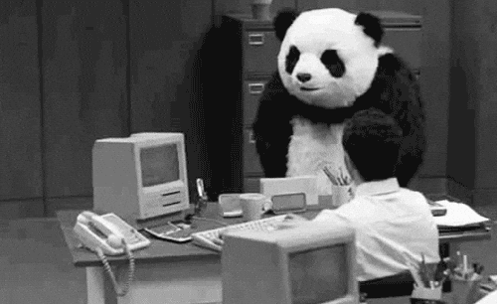
Words to remember…
Programming can be immensely rewarding! When you can tackle a complex problem by writing a program it’s very exciting and fulfilling. When your boss can’t figure something out and you write code to solve the problem, it’s great.
Programming can be frustrating! If you forget to use proper syntax, forget how to use a specific module or class, leave a huge security hole in your program, it can be very annoying and exasperating because the code won’t execute.
You won’t learn how to write complex Python programs overnight. Give yourself time to learn, forgive yourself for mistakes; it will help. Don’t be afraid to make mistakes! You won’t destroy the world. Mistakes are an important way we discover and remember, especially when learning to program.
https://giphy.com/gifs/panda-table-flip-e24Q8FKE2mxRS

Slide 5


Useful Free Software
Anaconda software package
It installs the newest version of Python (v3.x) on Windows, Mac, or Linux computers
It comes with pre-installed Python libraries for us to use
It will install Visual Studio Code, which is very useful (https://code.visualstudio.com/)
It installs Jupyter Notebook, which is a tool we can use to share our code (https://jupyter.org/)
https://anaconda.com/
https://www.anaconda.com/products/ai-navigator
https://docs.anaconda.com/ai-navigator/getting-started-ai-navigator/

Slide 6



Sign up for Free Accounts
Github - https://github.com/
HuggingFace - https://huggingface.co/
Langchain - https://www.langchain.com/langsmith
NOTE: These all offer free and paid accounts. If you are going to be serious about AI and LLM development with Python, you may need to pay for these services as the free accounts are limited.

Slide 7
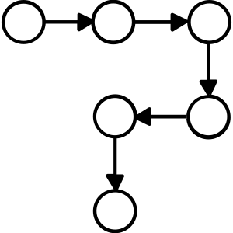
Step back and think about procedures (flow)
A procedure is simply a set of steps you follow to perform a task
Computers can’t perform tasks without procedures!
Writing procedures can be difficult:
You’ll forget a step
You’ll mistake the order
You’ll forget to transform data, etc..
An application contains all the procedures necessary to complete a task
Writing an application involves defining and writing all the steps for the computer to perform to accomplish some task
Remember: A computer performs a task precisely as you write it! A computer will not catch your mistakes and compensate.

Slide 8




Programming Languages
Human speech is imprecise! Computer are literal!
We need another language to get things done…
Programming languages make it possible to write procedures that are both precise and can be understood by both humans and computers

Slide 9
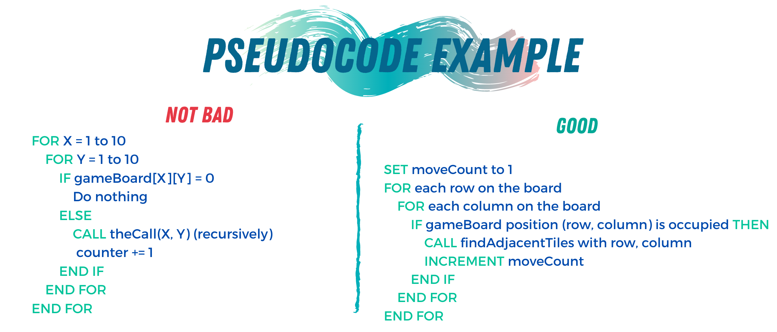
Pseudocode
Pseudocode: English-like description of an algorithm in a made-up computer language
Write up pseudocode for your program
Turn each statement into a comment in your script
This creates an outline so you can write your code!
https://towardsdatascience.com/pseudocode-101-an-introduction-to-writing-good-pseudocode-1331cb855be7

Slide 10
Rocks
Programming languages are plentiful! https://en.wikipedia.org/wiki/List_of_programming_languages_by_type
Python code is 2-10x shorter than comparable code writing in other languages
Python code is easier to read (for a human) than other languages
Python is easy to learn!
Check out: https://www.python.org/about/success/

Slide 11
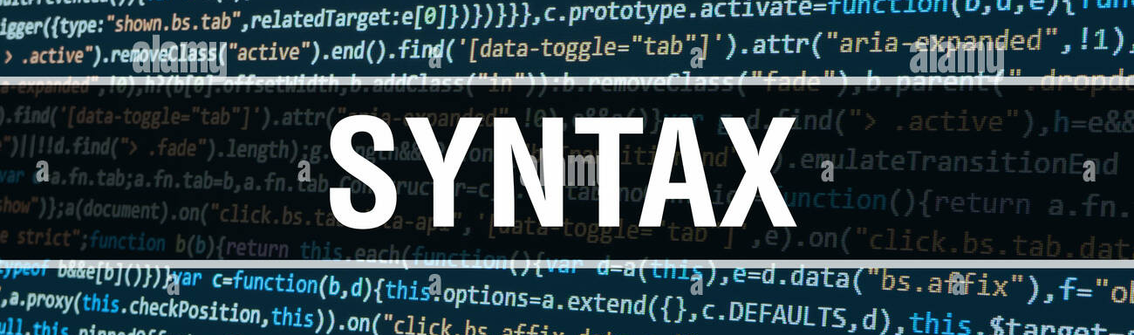
Python Syntax
Look at the PEP 8 -- Style Guide for Python Code https://www.python.org/dev/peps/pep-0008/
It’s all about CONSISTENCY!
Know when the style guide won’t work for your project but be consistent in whatever you do.
Indentation => 4 spaces This is default in many editors
Spaces are preferred over tabs
Python 3 doesn’t allow mixing of tabs and spaces for indentation
Line Length => 79 characters

Slide 12
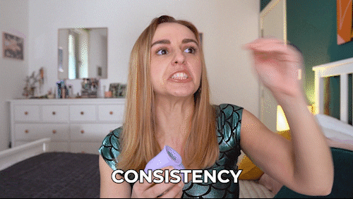
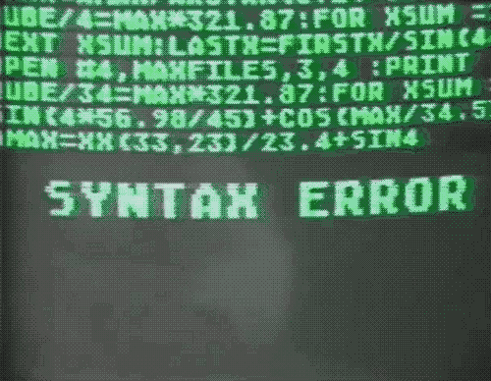
--->
BE CONSISTENT!
or
BE FRUSTRATED
https://giphy.com/gifs/HannahWitton-hannah-witton-POhImPUEBl6bR2EIW0
https://giphy.com/gifs/mememe-ememe-memememmeme-Q0OqU2N1MN3KU

Slide 13
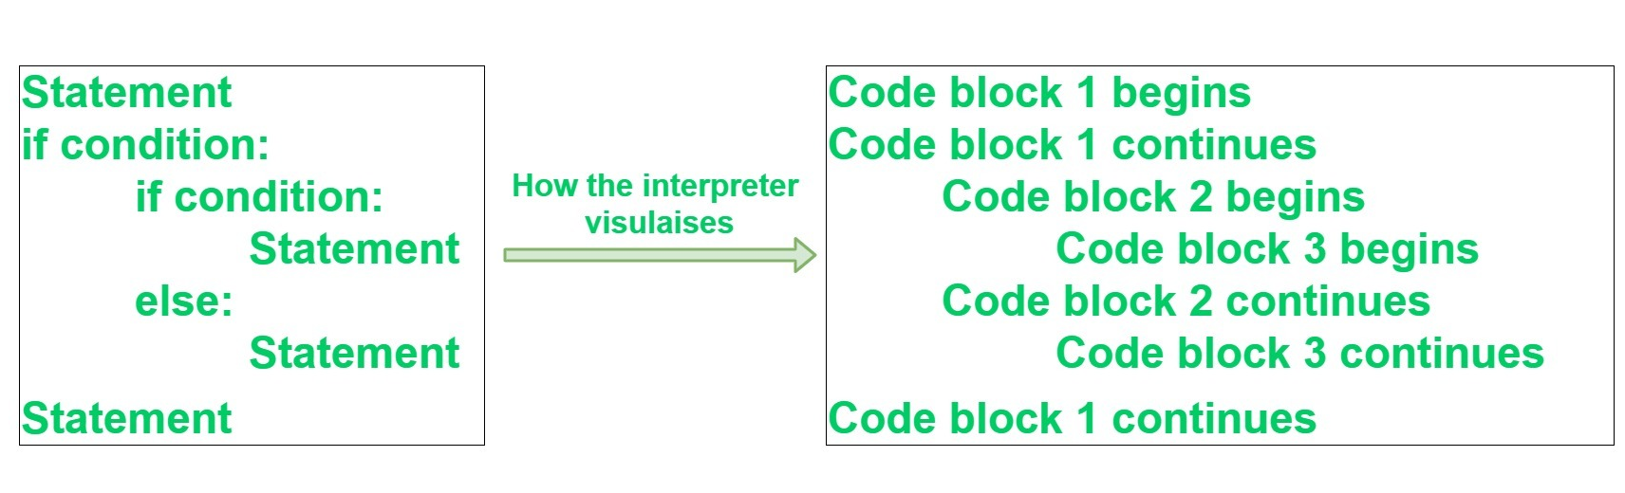
Python Block Syntax
Block Grouping:
A language that allows grouping with blocks is sometimes called a block structured language
Indentation is used to distinguish a block in Python
A block is a group of statements in a script
Some languages use { … } to distinguish blocks (like JavaScript or PHP)
In Python, code blocks are defined by their indentation
The statements within a block will line up vertically
Block 1
4 spaces
Block 2
8 spaces
Block 3
4 spaces
Block 2, continuation
Block 1, continuation
PEP 8 recommends that you always use 4 consecutive spaces to indicate indentation. This is what we will do!!!
NOTE: You can use spaces or tabs! But it MUST be consistent, or you will receive an error when you try to execute the script.

Slide 14

Storing Information
Variables
It means: something that changes
are a way of referring to a memory location used by Python (or basically any computer program)
In many programming languages, a variable is a symbolic name for a physical location
Think of it as a container
A variable stores the assigned information, which we can access through its name
42
bucket
<variable> = <expression>
bucket = 42
assignment -> not equals
print(bucket) → This outputs the value of: 42
Notes:
You will be required to add comments to all the code you write in this course.
This allows me to see that you understand what is happening and it allows you to think about what you are doing in your code.
Remember, a program can be thousands of lines of code and you can forget what is happening in chunks of code unless you add comments! Trust me, I get so mad at myself when I forget to comment code and come back to it a few weeks after I wrote it and can’t remember why I did what I did. It’s important.

Slide 15

Variables - Case Sensitivity
Variable names and keywords are case sensitive.
fooBar = "Tim"
foobar = "Tim"
These are two different variables!
This will drive you crazy in your coding if you accidentally capitalize a variable name one place in the code and don't capitalize it in another. The code won't work as you expect. REMEMBER THIS!
foobar
fooBar
Notes:
You will be required to add comments to all the code you write in this course.
This allows me to see that you understand what is happening and it allows you to think about what you are doing in your code.
Remember, a program can be thousands of lines of code and you can forget what is happening in chunks of code unless you add comments! Trust me, I get so mad at myself when I forget to comment code and come back to it a few weeks after I wrote it and can’t remember why I did what I did. It’s important.

Slide 16

Assignment Statement
An assignment statement is:: a line of code in which a variable is given a value
<variable> = <expression> (expression can be many different things!)
If the variable has never been assigned before, Python allocates an empty slot of memory, attaches the name to it, and puts in the value

Slide 17
Assignment Statement (cont)
44
44
myAge
You can assign a variable's value to another variable OR combine values to create a new value for another variable OR ….
myAge
yourAge
44
44
myAge
yourAge
myAge = 44
yourAge = myAge
print(yourAge) # output is 44
nMales = 23
nFemales = 21
nPeople = nMales + nFemales
print(nPeople) # ouptut is 44
23
21
+
44
nMales
nFemales
nPeople

Slide 18
Python - Basic Data Types
Integers --> int
Includes positive and negative integers, including zero; no decimals
1, 2, 100, 1235456
Floats --> float
Real numbers with decimal points
1.1, 3.14, 569.32
Strings --> str
Also known as text, contains any sequence of characters
"Here's a string with a single quote in it."
Booleans --> bool
Only two possible values: True or False (must be assigned capitalized)
Notes:
You will be required to add comments to all the code you write in this course.
This allows me to see that you understand what is happening and it allows you to think about what you are doing in your code.
Remember, a program can be thousands of lines of code and you can forget what is happening in chunks of code unless you add comments! Trust me, I get so mad at myself when I forget to comment code and come back to it a few weeks after I wrote it and can’t remember why I did what I did. It’s important.

Slide 19
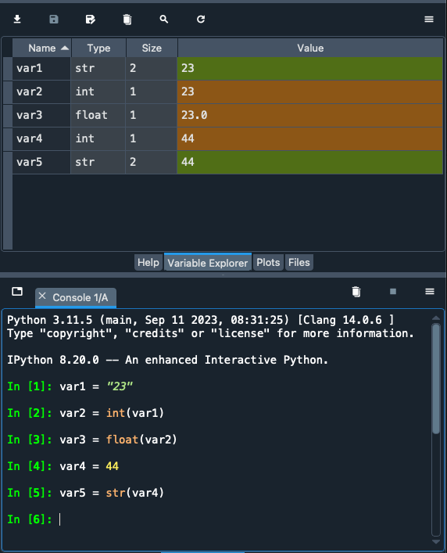
Casting Values
You can specify a type on any variable and Python will treat it as such; this is called CASTING
We can use Python's constructor functions that are built into the language to do this:
int() – constructs an integer number
float() – constructs a float number
str() – constructs a string

Slide 20
Python - Numbers & Expressions
OPERATOR | DEFINITION
+ | Addition
- | Subtraction
* | Multiplication
/ | Division (float)
% | Modulus
** | Power
// | Integer Division
Notes:
You will be required to add comments to all the code you write in this course.
This allows me to see that you understand what is happening and it allows you to think about what you are doing in your code.
Remember, a program can be thousands of lines of code and you can forget what is happening in chunks of code unless you add comments! Trust me, I get so mad at myself when I forget to comment code and come back to it a few weeks after I wrote it and can’t remember why I did what I did. It’s important.

Slide 21
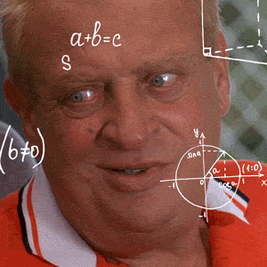
Math - Order of Operations
PEMDAS:
Parentheses
Exponents
Multiplication
Division
Addition
Subtraction
https://giphy.com/gifs/rodneydangerfield-thinking-math-rodney-gEvab1ilmJjA82FaSV
x = 5 + 4 * 9 / 6
x = 5 + 36 / 6
x = 5 + 6.0
x = 11.0
Why is it 11.0 and not just 11?

Slide 22
Keywords in Python
and | as | assert | break | class
continue | def | del | elif | else
except | exec | if | import | in
is | lambda | not | or | pass
print | raise | return | try | while
yield | True | False | None
You can't use any of these as variable names. They are reserved by Python
because they already have built-in functionality.
https://docs.python.org/3/library/keyword.html#module-keyword

Slide 23
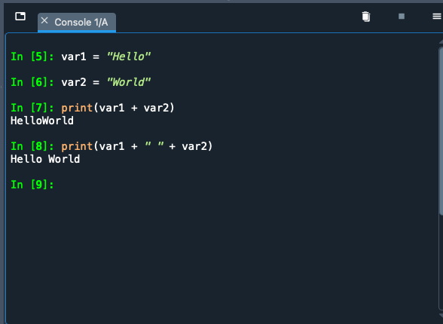
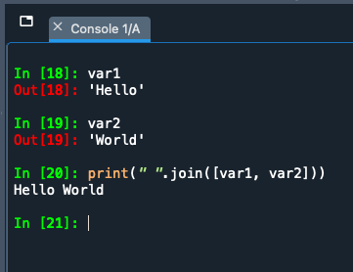
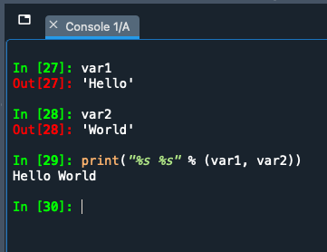
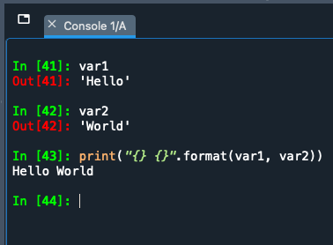
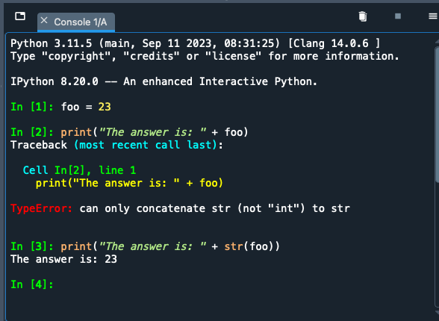
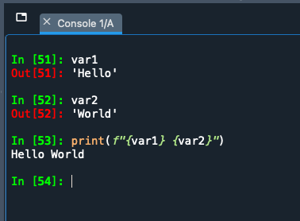
Basic Concatenation (examples)
'+' operator
join() method
'%' operator
format() function
I personally prefer this method because I can see the variables easily
must force Python to treat int as str using str() function
Python F-string (https://peps.python.org/pep-0498/)

Slide 24
LOGIC with the if … else
We can run very simple logic using 'if … else'.
We are asking Python to run code based on a (series of) test(s) https://docs.python.org/3/reference/compound_stmts.html#index-3
First, the code asks to test whether a statement is TRUE
If it is TRUE, it runs a certain chunk of code
If it is FALSE, it skips the TRUE code and runs the else chunk of code.
if condition is True
condition
execute if code chunk
if condition is False
execute else code chunk
colon
4 spaces indentation
if <condition>:
print("This condition was True")
else:
print("The condition was False")
colon
4 spaces indentation

Slide 25
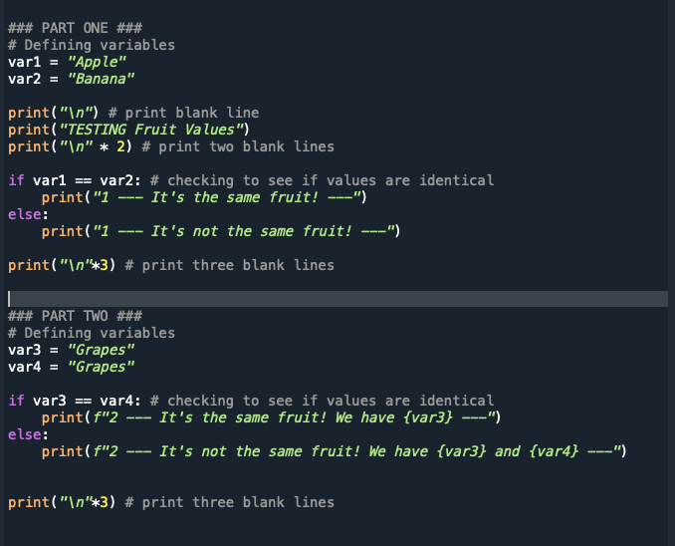
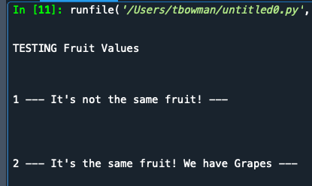
if … else → Comparison of values example using ==
REMEMBER: In Python, code blocks are defined by their indentation. The statements within a block will line up vertically
Block 1
4 spaces
Block 2
8 spaces
Block 3
4 spaces
Block 2, continuation
Block 1, continuation
CODE >> simpleIf-Else.py

Slide 26
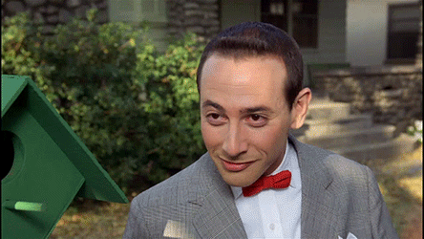
if … elif … else
if <condition>:
print("first condition is True")
elif <condition>:
print("second condition is True")
elif <condition>:
print("third condition is True")
else:
print("none of the conditions were True")
if condition
if condition #1 is True
execute if code chunk
elif condition #n
if condition #n is True
execute elif code chunk
if ALL conditions are False
else code chunk
https://giphy.com/gifs/aI7Ret2L4hnMI

Slide 27
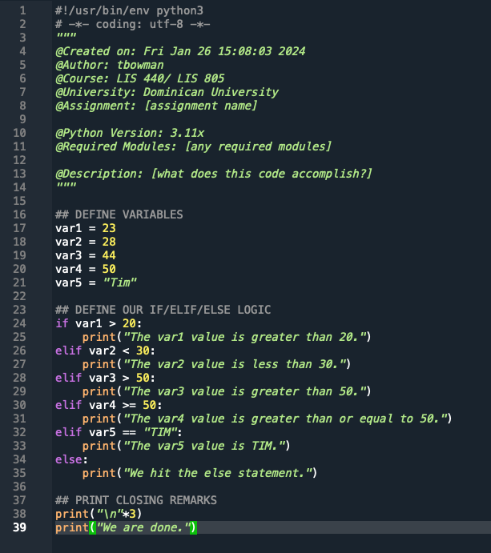
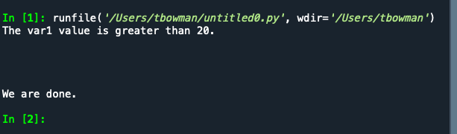
if … elif … else
NOTE: The conditions are MUTUALLY EXCLUSIVE.
Once one condition is triggered in this if..elif..else, none of the other conditions are checked.

Slide 28
List of Built-in Functions
abs() | dict() | help() | min() | setattr()
all() | dir() | hex() | next() | slice()
any() | divmod() | id() | object() | sorted()
ascii() | enumerate() | input() | oct() | staticmethod()
bin() | eval() | int() | open() | str()
bool() | exec() | isinstance() | ord() | sum()
bytearray() | filter() | issubclass() | pow() | super()
bytes() | float() | iter() | print() | tuple()
callable() | format() | len() | property() | type()
chr() | frozenset() | list() | range() | vars()
classmethod() | getattr() | locals() | repr() | zip()
compile() | globals() | map() | reversed() | __import__()
complex() | hasattr() | max() | round()
delattr() | hash() | memoryview() | set()
https://docs.python.org/3/library/functions.html

Slide 29
User-Defined Functions
User-Defined Functions give us power and save us time!
A function: series of related steps (statements) that make up a task, which can be called in multiple locations within a program.
def: stands for definition. We are defining a new function for Python to use; it stores the location of the function in memory.
When naming user-defined functions, keep the name simple and generic!
Keep functions at the top of your code! If you try to call a function before you define it, you'll receive an ERROR.
Don't forget the colon!
def <functionName>(optionalParameters):
<indentedStatements> # this makes up the body of the function
Don't forget the indentation!

Slide 30
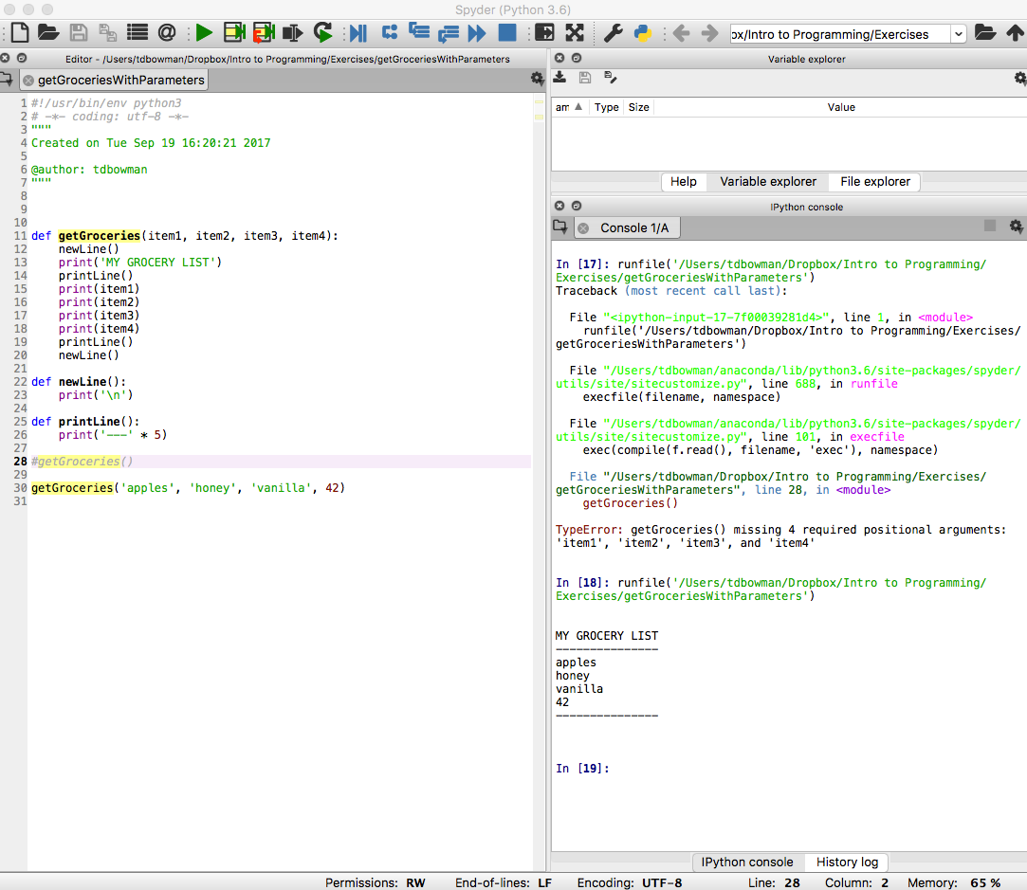
Function Parameters
Parameter: a variable that is assigned a value when the function starts. This is important! Unless you assign a default value to the parameter (which we'll talk about later), the parameter variable is empty.
NOTE: There are 4 parameters in the function 'getGroceries'.
def getGroceries(item1, item2, item3, item4):
print('I need ' + item1)
print('I need ' + item2)
print('I need ' + item3)
print('I need ' + item4)
print('\n') #blank line
If you execute with line #28 not commented you will receive ERROR!
Each parameter takes on the value and the type of whatever argument is passed in.

Slide 31
Simple Addition Function
Task:
Build a routine that (1) accepts a numeric parameter, (2) adds the parameter variable to 2, and (3) print the result.
def addTwo(startingVal):
endingVal = startingVal + 2
print('The sum of ' + str(startingVal) + ' plus 2 is: ' + str(endingVal))
print('\n') #blank line
NOTE: There is only 1 parameter in this function.
-- Also, I'm using built-in functions(i.e. the str() function) inside my user-defined function!

Slide 32
Returning one Value (instead of printing)
Task:
Build a routine that (1) accepts a numeric parameter, (2) adds the parameter variable to 2, and (3) returns the result.
return <returnValue>
def addTwo(startingVal):
endingVal = startingVal + 2
return endingVal #return here
NOTE 1: There is only 1 parameter in this function. It no longer prints the results; instead, it returns the value.
NOTE 2: Whenever you use a return statement in a function, the execution of the code exits (stops) immediately and you are returned to the main body of code where the function was called!

Slide 33

Scope
Scope: the amount of code over which a variable is active.
This is important to understand, otherwise you won't get the results you expect!
Variables can ONLY be used after they have been declared!!!
Functions can ONLY be used after they have been defined!!

Slide 34
Scope (cont)
A variable defined in the main body (top level) of a program is called a global variable. You can also specifically define a variable as global.
Global variables are available throughout a program (after they are initially defined)
You can use a global variable inside a function without causing a Python error, but it is strongly NOT recommended; it can be confusing. Instead of using a global var inside a function, pass it as a parameter into the function.
A variable defined inside a function is referred to as a local variable
Local variables only exist inside the function once it is run and cease to exist after the function has ended running
A variable defined as nonlocal is useful when nesting functions (see link below)
The usage of nonlocal is very similar to that of global, except that the former is used for variables in outer function scopes and the latter is used for variable in the global scope.
https://www.smallsurething.com/a-quick-guide-to-nonlocal-in-python-3/

Slide 35
Loops
Loop: A block of code that is repeated until a certain condition is met.
Most modern apps would not function without loops!!!
https://realpython.com/python-for-loop/
https://realpython.com/python-while-loop/

Slide 36
While Loop
The syntax for a while loop is similar to the if statement
The body of the loop is the code that is indented within the while statement
As long as the Boolean expression is True, the statements in the body of the loop are repeated
When the Boolean expression is False, the body of the loop is skipped and execution continues with first line after while statement
# runs as long as the expression
# evaluates to True
while <Boolean expression>:
<indented block of code>
NOTE: If the condition never equals False, the loop will run infinitely! This is called an "infinite loop"

Slide 37
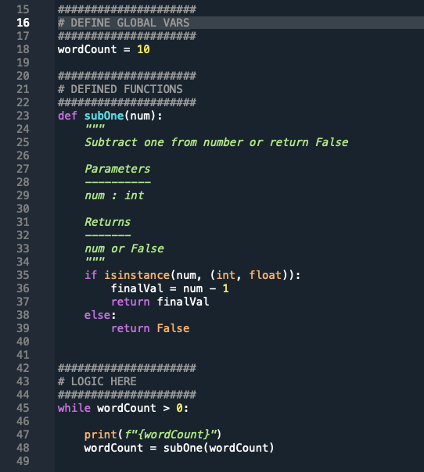
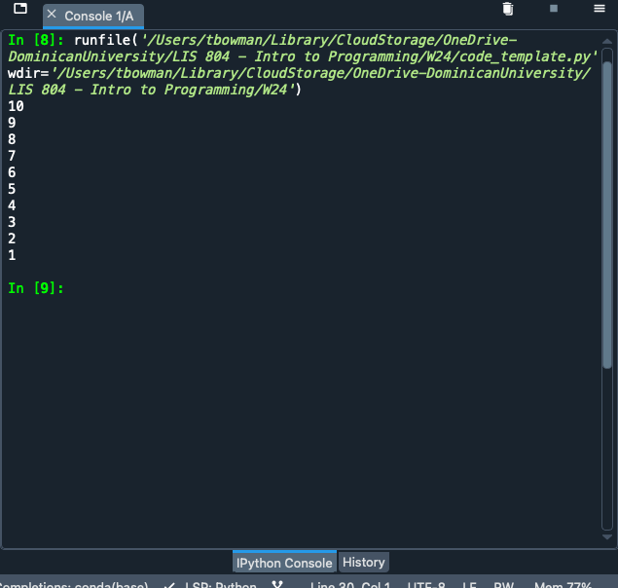
Loops and User-Defined Function
Running this subOne(num) function inside while loop

Slide 38
for Loop
for loop: The code executes a set number of times
The for loop works through a sequence of some type
The <variable> in the for loop is assigned a single element in the sequence each iteration
for <variable> in <sequence>: <statements>
else:
<statements>

Slide 39
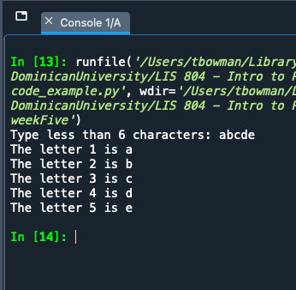
for Loop
pretend user typed "abcde"
letterNum = 1
value = input("Type less than 6 characters: ")
for letter in value:
print(f"The letter {letterNum} is {letter}")
letterNum += 1 # add one to counter
if letterNum > 6: # perform check on value
print("The string is too long!")
break
for <variable> in <sequence>
test iteration
'break' allows us to exit loop

Slide 40
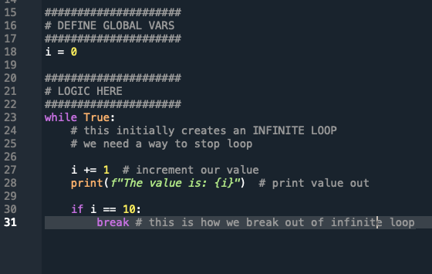
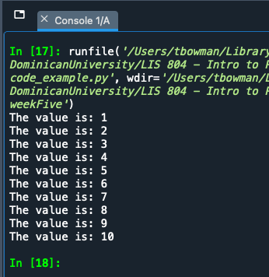
break
break - control is immediately transferred to the first statement past the last line of the loop
The technique of writing an infinite while loop using a while True statement and using break is effective and clear.

Slide 41
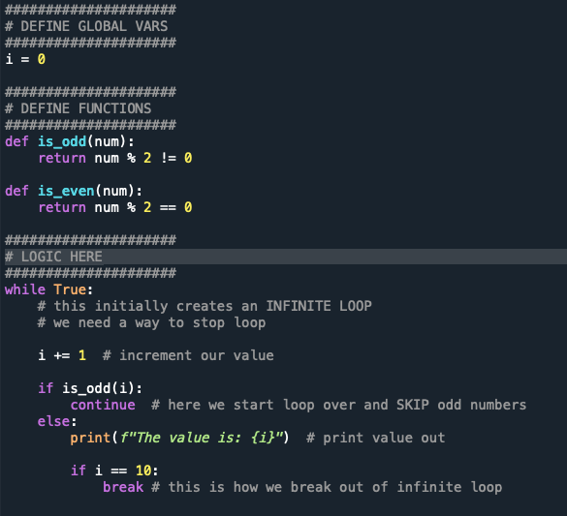
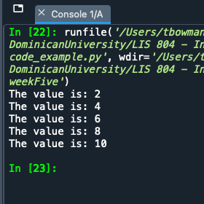
continue
continue- the execution of the code is immediately passed back to the beginning of the loop
Whatever code is after the continue gets skipped.

Slide 42
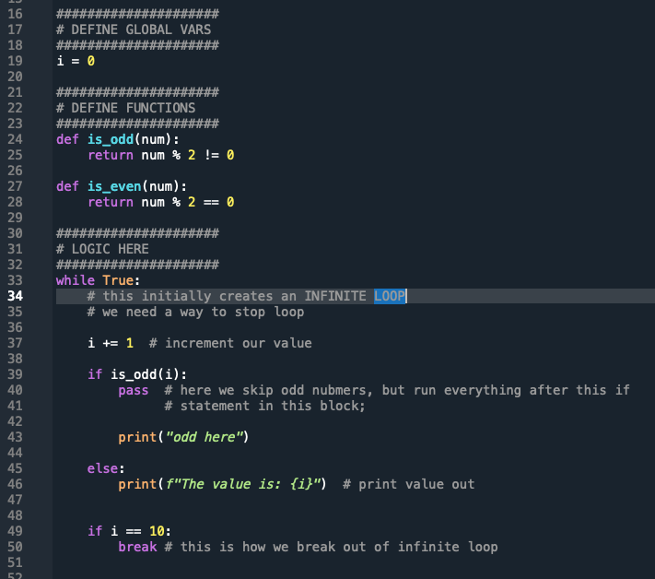
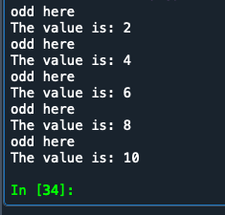
pass
pass - works almost the same way as continue, except that it allows completion of the code in the if code block in which it appears
it allows for post-processing on the element

Slide 43
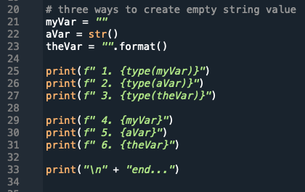
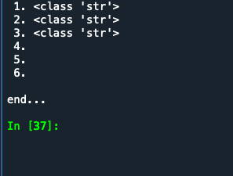
empty string
empty string - value of no characters; represented by two quotes; considered a string data type
can be either '' or ""
this is different from None value
can be of value to hold spot in lists or dictionaries

Slide 44
Data Structure
A data structure is a collection of multiple pieces of data, arranged in a way that the data can be accessed efficiently.
Tuple
Immutable Array
Lists
Mutable Array
Dictionaries
Hashtables

Slide 45
Lists --- []
Lists are a kind of sequence.
Sequence is a means of allowing multiple data to exist together in a single unit, but as separate entities.
Lists are mutable!
This has a beginning, middle, and end (just like on a piece of paper)

Slide 46
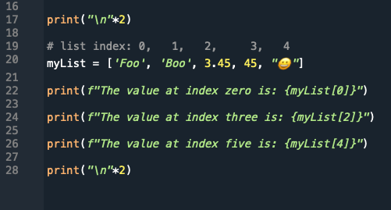
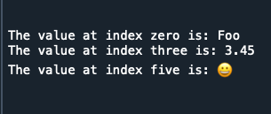
Creating Lists – []
NOTE: It's best practice to create lists of the same type, though Python allows us to created mix-typed lists, too (as mentioned on the previous slide)
Creating a list is somewhat like creating a variable with a single value:
index
0, 1, 2, 3, 4
myList = ["One", 4, "Tim", 3.45, False]

Slide 47
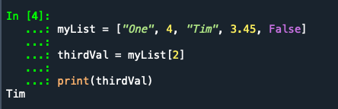
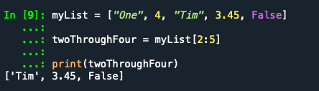
Accessing data from our lists
Remember: It's a zero-based index!
To get the third item in our list, what do we use???
We can also get a range of values back from our list using a colon. NOTE: The second parameter is the number after the one we want See below!
[ 0, 1, 2, 3, 4 ] ← list indexes
myList = ["One", 4, "Tim", 3.45, False]
thirdVal = myList[2]
We ask for index 2, NOT 3!
Why did I use 5 here???

Slide 48
List of lists
The data inside a list can be any data type.
This can be: int(), float(), str(), Boolean, or even a list
NOTE: in other programming languages a list of lists is called a multidimensional numerical array
>>> myList = [5, 3.4, [1,2,3], 33, 109]
>>> print(myList)
[5, 3.4, [1,2,3], 33, 109]
>>> print(myList[2])
[1,2,3]
<outerList>[<outerListIndex>][<innerListIndex>]
>>> print(myList[2][1])
remember
We add 2nd index to access our nested list value

Slide 49
Tuple ---> ()
Tuples are a kind of sequence.
Tuples (generally) are sequences of different kinds of stuff, and you deal with the tuple as a coherent unit.
A tuple is generally enclosed in parentheses.
Tuples are immutable!
There is considerable overlap in the ways tuples and lists can be used, but the built-in capabilities of the two structures highlight some of the distinctions (from: http://news.e-scribe.com/397).
A tuple has a numeric index (like a list)!

Slide 50
Creating Tuples
Creating a tuple is similar to creating a list:
index
0, 1, 2, 3,
tuple name
open/close parentheses
myTup = ("Tim", "Bowman", "Asst", 2016)
assignment

Slide 51
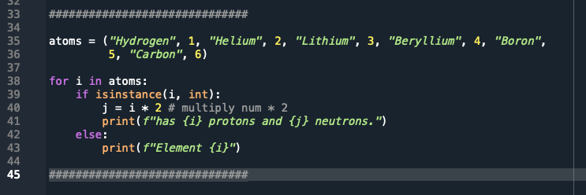
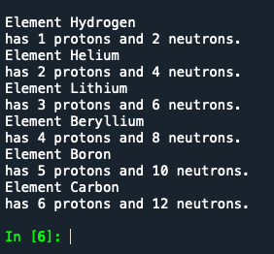
isinstance()

Slide 52
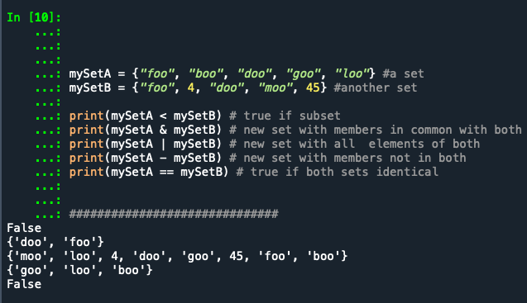
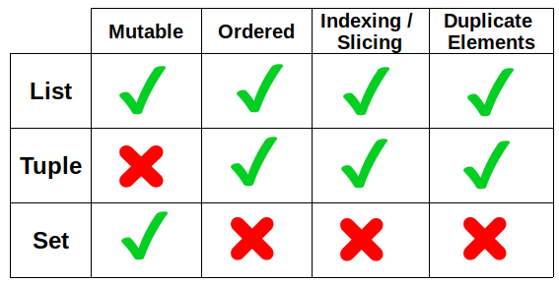
set ---> {}
Sets are an unordered collection of objects (NOT a sequence)
An element can only be a member of a given set once
Think of sets like a mathematical set, which we can compare
When you create a set in Spyder, notice that it doesn't show up in variable explorer!
Subset set1 < set2 means set1 is a true subset of s2.
Intersection set1 & set2 creates a new set containing members in common with both.
Union set1 | set2 creates a new set with all elements of both.
Difference set1 - set2 creates a new set with members that are not in both.
Equality set1 == set2 is true if both sets contain only the same elements.

Slide 53
Dictionary {}
Dictionary: similar to a list, but data is represented in what are called key/value pairs… not using a numerical index like a list[] or tuple()
The key/value is separated by a colon :
Python represents dictionaries with {} curly braces; when you see curly braces in code, you know it's a dictionary in Python
{<key>:<value>, <key>:<value>, ..., <key>:<value>}
demographDict = {'gender':'female', 'age':40, 'education':'college', 'ethnicity':'Asian', 'marital':'single'}
NOTE: in other programming languages a dictionary is called an associative array
key
value
pair

Slide 54

Dictionary {} - Described
gender = 'female'
age = 40
education = 'college'
ethnicity = 'Asian'
marital = 'single'
5 Variables
become
1 Dictionary
demographDict
demographDict = {
'gender':'female',
'age':40,
'education':'college',
'ethnicity':'Asian',
'marital':'single'
}
CURLY BRACES {}
note we can have an integer as value (no quotes)

Slide 55
Dictionary - Retrieving Data
demographDict = {
'gender':'female',
'age':40,
'education':'college',
'ethnicity':'Asian',
'marital':'single'
}
>>> print(demographDict['age'])
40
>>> print(demographDict['marital']
single
NOTE: With a dictionary, we do NOT have a numeric index! We have key/value pairs.
we use the key to retrieve the value

Slide 56
Dictionary - Updating/Adding Data
demographDict = {
'gender':'female',
'age':40,
'education':'college',
'ethnicity':'Asian',
'marital':'single'
}
# ADDING data to dictionary
>>> demographDict['veteran'] = False
# UPDATING data in dictionary
>>> demographDict['marital'] = 'married'

Slide 57
Dictionary - Iterating through
>>> demographDict = {
'gender':'female',
'age':40,
'education':'college',
'ethnicity':'Asian',
'marital':'single'
}
>>> for characteristic in demographDict:
value = demographDict[characteristic]
print('\t',characteristic,' : ',value)
gender : female
age : 40
education : college
ethnicity : Asian
marital : single
>>> for (key,val) in demographDict.items():
print('\t', key, " : ", val)
gender : female
age : 40
education : college
ethnicity : Asian
marital : single

Slide 58
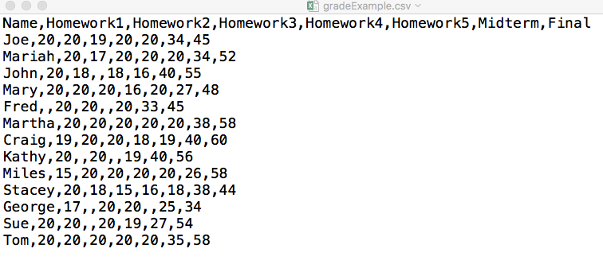
CSV Files (Comma Separated Value)
Parse: take information and separate it into more easily processed components
When looking at a CSV file in a text editor, note that the first line contains the titles of the columns.
CSV Files - csv package
https://docs.python.org/3.6/library/csv.html

Slide 59
JSON: JavaScript Object Notation
{ "base":"USD", "date":"2016-05-13", "rates":{ "AUD":1.3728, "BGN":1.7235, "BRL":3.486, "CAD":1.2882, "CHF":0.97145, "CNY":6.5211, "CZK":23.811, "DKK":6.556, "GBP":0.69403, "HKD":7.7632, "HRK":6.6109, "HUF":277.73, "IDR":13318.0, "ILS":3.7737, "INR":66.78, "JPY":108.88, "KRW":1172.8, "MXN":18.05, "MYR":4.0299, "NOK":8.1669, "NZD":1.4709, "PHP":46.645, "PLN":3.8711, "RON":3.9633, "RUB":65.271, "SEK":8.2204, "SGD":1.3705, "THB":35.43, "TRY":2.9643, "ZAR":15.168, "EUR":0.88121 } }
https://docs.python.org/3.6/library/json.html
{"base":"USD","date":"2016-05-13","rates":{"AUD":1.3728,"BGN":1.7235,"BRL":3.486,"CAD":1.2882,"CHF":0.97145,"CNY":6.5211,"CZK":23.811,"DKK":6.556,"GBP":0.69403,"HKD":7.7632,"HRK":6.6109,"HUF":277.73,"IDR":13318.0,"ILS":3.7737,"INR":66.78,"JPY":108.88,"KRW":1172.8,"MXN":18.05,"MYR":4.0299,"NOK":8.1669,"NZD":1.4709,"PHP":46.645,"PLN":3.8711,"RON":3.9633,"RUB":65.271,"SEK":8.2204,"SGD":1.3705,"THB":35.43,"TRY":2.9643,"ZAR":15.168,"EUR":0.88121}}
HINT: PRETTY IT UP > https://jsonformatter.curiousconcept.com/,
https://codebeautify.org/jsonviewer,
https://jsonformatter.org/
Notes:
Chapter 11 - Data Structures
Learn to Program with Python
Reading a Comma-Separated Value (.csv) File

Slide 60
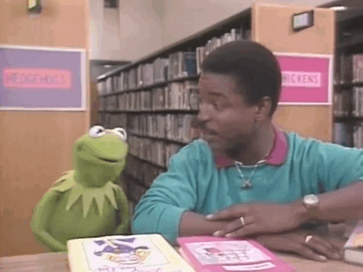
Modules
Because programs can contain thousands/millions of lines of code, a way of organization is needed. In Python, commonly used code organized into small chunks are called modules.
Generic types of commonly used code are called libraries. These terms, modules and libraries, are sometimes used interchangeably
https://giphy.com/gifs/readingrainbow-kermit-the-frog-levar-burton-xT1XGw3b5osvin2IXC
https://docs.python.org/3/tutorial/modules.html

Slide 61
Importing
In order to use a module or library, you need to import the file.
This is always done at the top of the script (after the docstring) so that module is loaded into memory and ready for use immediately.
You can import the entire module or parts of it.
import <someModule>
from <someModule> import <attributeName>
https://www.digitalocean.com/community/tutorials/how-to-import-modules-in-python-3

Slide 62
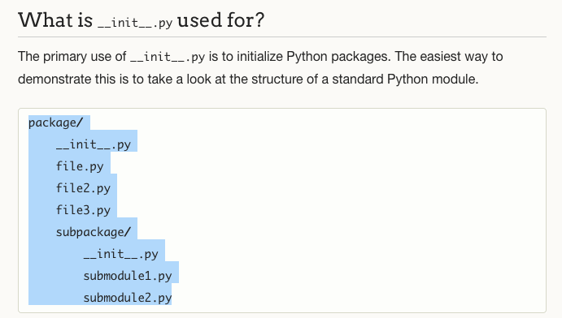
Package
A package is a hierarchical directory structure containing (potentially) many *.py files.
A top-level directory plus subdirectories
*.py files within the hierarchy
A file called __init__.py in each directory in the package
The __init__.py file tells Python the directory is part of a package and can contain configuration information and methods.
http://mikegrouchy.com/blog/2012/05/be-pythonic-__init__py.html
https://www.python-course.eu/python3_packages.php https://www.learnpython.org/en/Modules_and_Packages

Slide 63



Pandas, NumPy, Seaborn
There's also:
MatplotLib
Scikit-learn
SciPy
TensorFlow
Keras
PyTorch
NLTK
… more
https://numpy.org/doc/stable/user/absolute_beginners.html
https://pandas.pydata.org/docs/user_guide/10min.html
https://seaborn.pydata.org/tutorial.html

Slide 64
NumPy Library for Python
Universal standard for working with numerical data in Python
https://numpy.org/doc/stable/user/absolute_beginners.html
Supports Multidimensional Arrays and Matrix Data Structures
ndarray - n-dimensional array object with built-in methods you can use on the data
array → grid of values containing information about the raw data, how to locate an element in the array, and how to interpret an element.
supports large variety of mathematical operations on arrays

Slide 65

Pandas Library for Python
Pandas is a library built on top of the NumPy Library to analyze data and manipulate data
Two Primary Data Structures:
Series – one-dimensional labeled array (dictionary or NumPy array)
DataFrame – two-dimensional data structure (rows & columns like Excel)
https://giphy.com/gifs/panda-angry-breaking-EPcvhM28ER9XW
YouTube > Basic Guide to Pandas! [20min] https://www.youtube.com/watch?v=zN2Hua6oII0

Slide 66
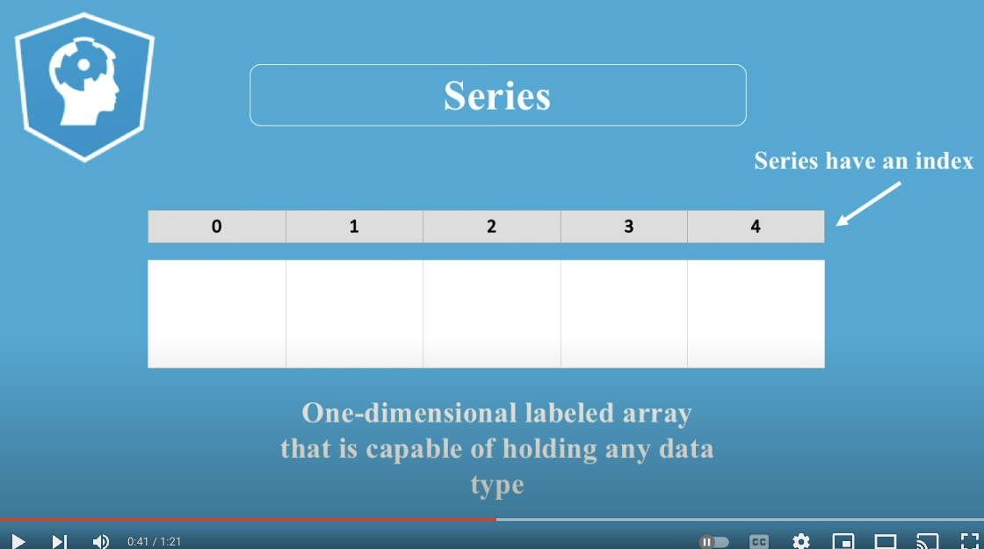
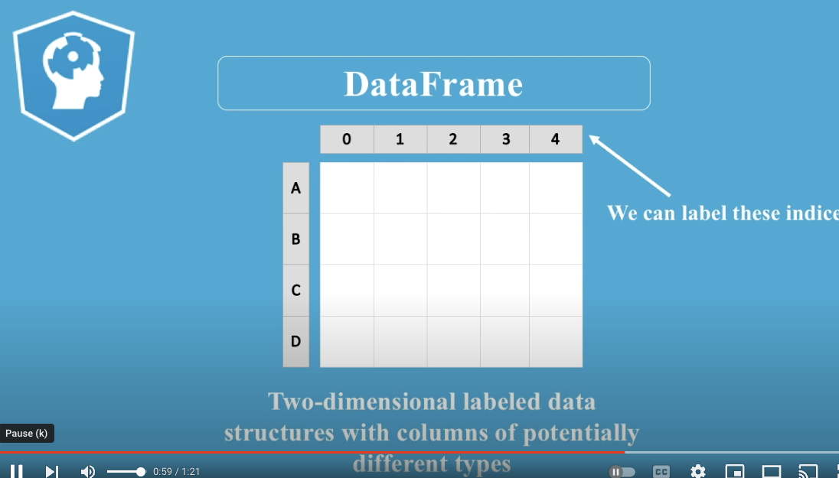
Pandas DataFrames
A DataFrame can contain:
DataFrame. (think Excel Spreadsheet)
Series. (think list)
ndarray – n-dimensional array (NumPy)
You an also specify the index and column names for a DataFrame
Index – indicates the difference in rows
Column Names – indicates difference in columns
https://www.youtube.com/watch?v=CLoNO-XxNXU&t=1s [90 seconds]

Slide 67
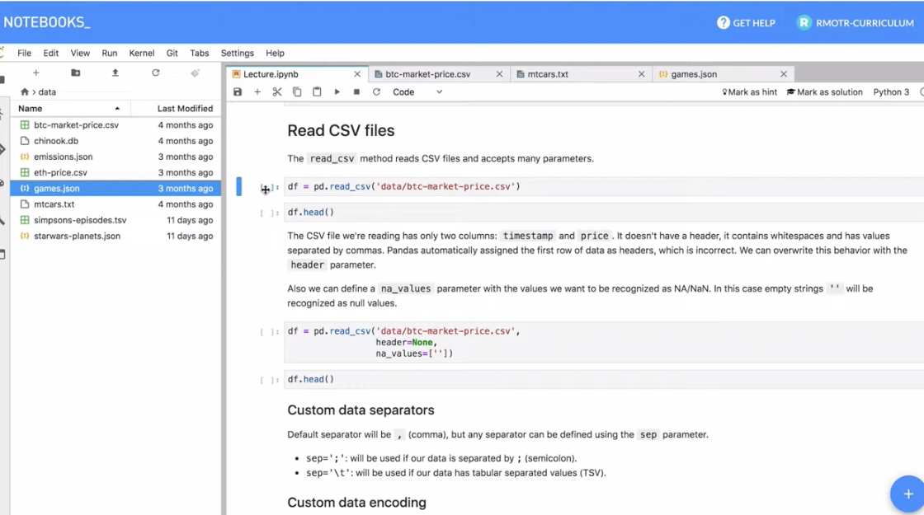
Pandas - Import Data from File
pandas.read_csv() – import any delimited file (comma, tab, semi-colon, etc) into dataframe
pandas.read_json() – import JSON file into dataframe
pandas.read_sql() – import from relational database system (MySQL, SQLite3, PostgreSQL, etc)
pandas.read_excel() – import from Excel doc
https://www.youtube.com/watch?v=fag1oWtskwU [13 min]
https://realpython.com/pandas-read-write-files/

Slide 68
seaborn Library for Python
Library for making statistical graphics in Python
built on top of MatPlotLib
operates on dataframes and arrays
supports a variety of graphics and plots
very customizable
https://seaborn.pydata.org/tutorial.html
https://realpython.com/python-seaborn/
see: https://seaborn.pydata.org/examples/index.html

